Slide 1
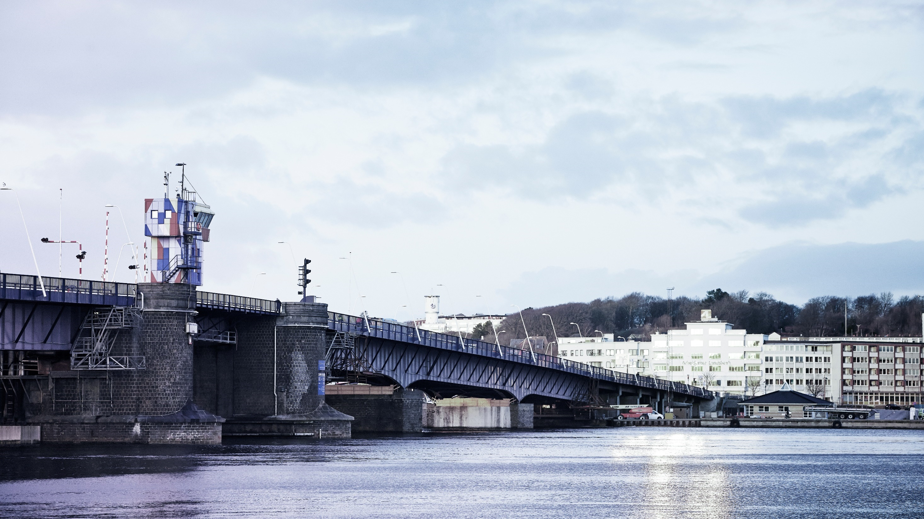
BONSAI ontology for sustainibility assessment Agneta Ghose, Aalborg University

Slide 2
Introduction
Ontologies are building blocks to support data integration
BONSAI ontology for sustainability assessment was developed based on description on the core data structure in wiki.
Principle- Develop a minimal ontology that encapsulates all dimensions of data required for sustainability assessments (LCA, IO, MFA)
Built upon concepts from existing LCA ontologies (Janowicz et al. 2015 )and widely known web ontologies such as OM ontology.
Notes:
An ontology is used to define the concepts and relationships to describe the database.

Slide 3
Dimensions of the core database (introduced in BONSAI)
Activity (class)- is defined as the act of doing
Flow (class) – corresponds to a ‘datapoint’ / an observation
Flow object (sub class of Flow)- is defined as an entity that is produced or consumed by activities or stored within an activity (stock).
Determining Flow (property)- is defined as a specific flow object produced by an activity to deliver its primary function
Input/Output (sub-class of Flow)- flow is an input or an output of an activity. This relation was made explicit as "isInputOf" or "isOutputOf“.
Flow – property (sub class of Flow)- This includes balanceable properties, properties for which the sum for all input flows must equal the sum for all output flows e.g. dry mass, water mass, energy, elemental mass, person-time, monetary value
Agent (class)- is defined as an entity (person or thing) that performs the activity. An agent has a specific location and the location of the activity is also determined by the agent performing it .
Stock (sub class of activity)- is defined as a type of activity where one/many flow objects are stored. Stocks can be with/ without temporal duration.
Other classes adopted from existing ontologies- Time (time), Location (schema/Geonames), Unit (om)

Slide 4
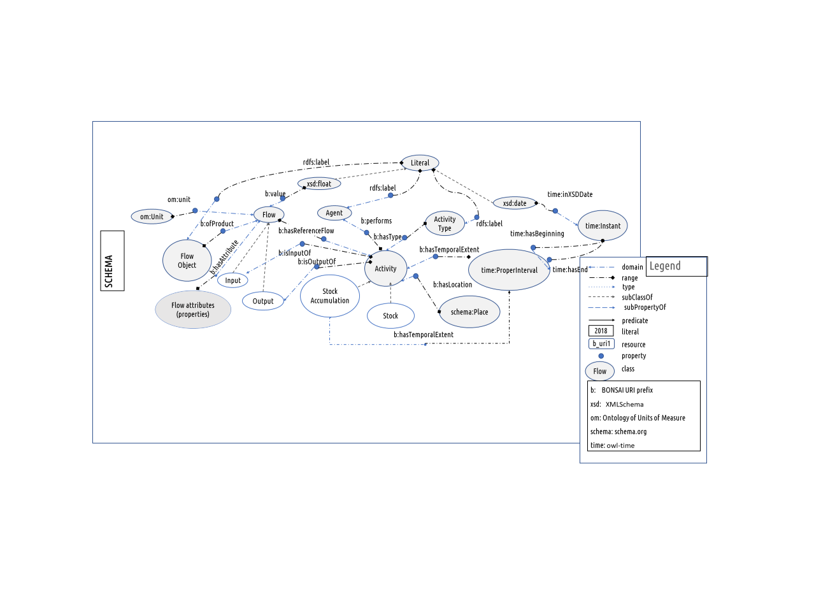
Current Schema
Example b:Activity b:Flow
b:isInputOf
Om:Unit

Slide 5
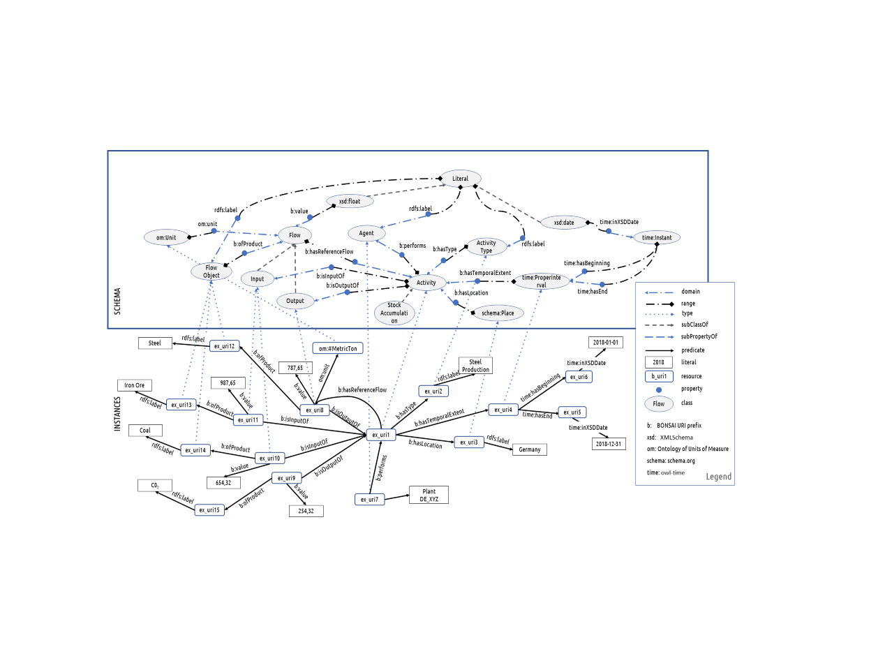
Notes:
Approximate Summary
Activity of type Steel Production performed by Agent Plant DE_XYZ, took place in 2018 in Germany, Had input of 654,32 Metric Tonnes of Coal, 987,65 Metric Tonnes of Iron Ore and produced 787,65 Metric Tonnes of Steel, and 254,32 Metric Tonnes of CO2.
The production of 987,65 Metric Tonnes of Steel is its determining flow.

Slide 6
Main discussions
Why do we have sub-classes of Input and Output flows? Can do without but it helps in developing queries
BONSAI ontology not specific for LCA community- if deemed necessary other research groups can develop a sub ontology.
Missing dimensions:
Property relation
Uncertainty
Add metadata (provenance, qualitative properties)
Building additional vocabulary to convert classification tables to RDF?

Slide 7
Deliverables
Create a "proper" ontology with a graphical representation.
Consider the vocabs QB and/or QB4OLAP
Complement ontology with an RDF schema
Place ontology and RDF schema on new github repo.
Link from wiki to new github repo and provide also here any arguments for choices made or alternatives considered.
Create namespace for the part of the ontology that is BONSAI-specific (i.e., which does not reside elsewhere): purl.org does not work for now, so we need to create something temporary
Coordinate classifications for activities and flow-objects (including biosphere flows) with #correspondencetables group

